Slide 1
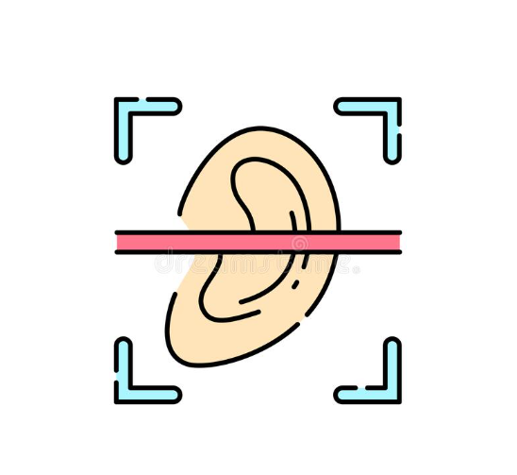
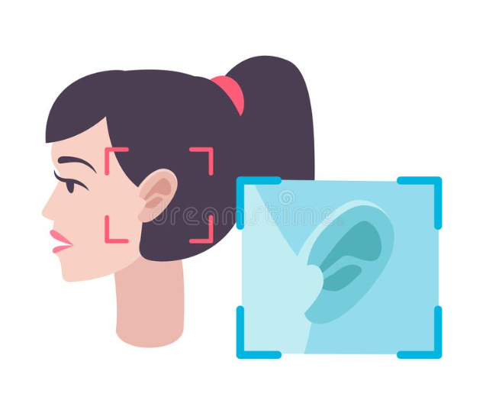
A Real-Time Embedded System for Person Recognition with Ear Biometrics

Slide 2




TEAM PRESENTATION~GROUP 4316
Humaira Anzum
ID: 190104031
190104031@aust.edu
Khandaker Iffat Jahan Tuli
ID: 190104035
190104035@aust.edu
Md. Abid Rahman
ID: 190104141
190104141@aust.edu
Fahim Al Rashid
ID: 190104080
190104080@aust.edu
Supervised By~
Dr. Md. Shamim Akhter
Professor
shamimakhter@gmail.com
Department of Computer Science and Engineering
Ahsanullah University of Science and Technology

Slide 3
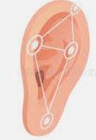
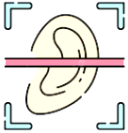
OVERVIEW
Introduction
Literature Review
Research Objective
Dataset
Working Methodology
Result Analysis
Future Plan
Conclusion

Slide 4
INTRODUCTION
Measurement of people’s unique physical characteristics
Accurate person identification by using unique physical characteristics
Biometrics
Basic Premise
Of Biometrics
Face
Iris
Ear
Voice
Fingerprint, etc.
A form of bimetric identification
Uses the unique features of ear for person identification
Biometric organs of human being
Ear Biometrics

Slide 5
INTRODUCTION~WHY EAR BIOMETRICS?
Every human being has a unique ear pattern
Uniqueness
The shape and appearance of the ear remain fixed throughout an individual’s lifetime
Biometric Permanence

Slide 6
INTRODUCTION (NON-MACHINE LEARNING METHODS)
First ear identification system was operated manually in 1949
After that, methods like template matching, morphological procedures were introduced
Requirements: Extensive manual image editing e.g., cropping images, extracting shapes etc.

Slide 7
INTRODUCTION (MACHINE LEARNING METHODS)
Identification, classification, and detection becomes very automated because of various types of convolutional neural networks
Simple and efficient algorithms for real-time ear detection: YOLOv3,v5; MobileNetSSDv1,v2
Focus of our work: Create a hardware system based on these deep learning algorithms to identify individual human beings through ear detection in real time.

Slide 8
LITERATURE REVIEW
Paper Title | Method / Models | Dataset | Training and Testing Accuracy
HEARD:An automatic human EAR detection technique | 1.Edge Detection 2.Boundary Verification 3.Color Segmentation | UND biometrics database(2414 pictures) | Training Accuracy: 98%
Automatic ear detection and feature extraction using Geometric Morphometrics and convolutional neural networks | 1.Geometric Morphometrics 2.CNN | CANDELA database(7500 images) | Test accuracy : 92.43%

Slide 9
LITERATURE REVIEW
Paper Title | Method / Models | Dataset | Training and Testing Accuracy
Real-Time Human Ear Detection Based on the Joint of Yolo and RetinaFace | 1.RetinaFace 2.Deformable Convolutional Networks. 3.Cascade R-CNN 4.YOLOV3 | Face database of 1000 Asian celebrities. | Training Accuracy: 71.2%
Real time ear recognition using deep learning | 1.CNN 2.Principle Component Analysis(PCA) 3.R-CNN | Random images of 13 people (534 images) | Training accuracy : 97%

Slide 10
LITERATURE REVIEW
Paper Title | Method / Models | Dataset | Training and Testing Accuracy
A deep learning approach for person identification using ear biometrics | 1.Manual image processing. 2.CNN | 1.AMI EAR dataset 2.IITD - ii EAR dataset | Training Accuracy: 97.36% Testing accuracy : 91.99%
A Real-time Machine Learning-Based Person Recognition System with Ear Biometrics | 1.Gaussian Process Classifier(GPC) 2.Principle Component Analysis(PCA) 3.Independent Component Analysis(ICA) 4.YOLOV3 | EarVN1.0 dataset(164 classes and 28412 images) | Training accuracy : 98.5% Testing accuracy : 85%

Slide 11
OBJECTIVES
1
Comparison between the performance of YOLOv5, MobileNet SSD V1 and V2 on EarVN1.0 dataset and selecting the best algorithm.
Creating a dataset named AUSTEarID205X10 and preprocessing the images of these dataset using HAAR Cascade algorithm and training the selected model on the dataset.
2
Setting up a hardware system based on HAAR Cascade and the pre-trained model for real time ear recognition.
3

Slide 12
DATASET
EarVN1.0 Dataset | AUSTEARID205x10 Dataset
A dataset of 164 different classes. | A dataset of 10 different classes collected from AUST. The ear images were detected and extracted through haarcascade classifier.
The dataset a total of 27592 images distributed in 164 classes/persons. Randomly 10 people were chosen, totaling 2057 pictures. | Each person/class has 205 different ear images with a total of 2050 images.
Training purpose: 85% Validation purpose: 5% Testing purpose: 10% | Training purpose: 70% Validation purpose: 15% Testing purpose: 15%

Slide 13
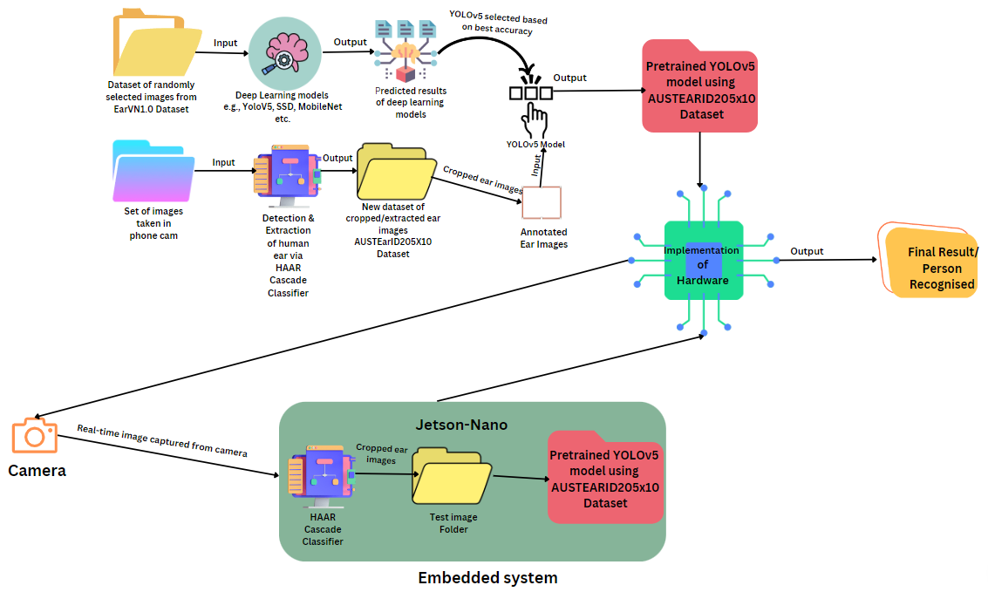
WORKING METHODOLOGY

Slide 14
WORKING METHODOLOGY
YOLOv5

Slide 15
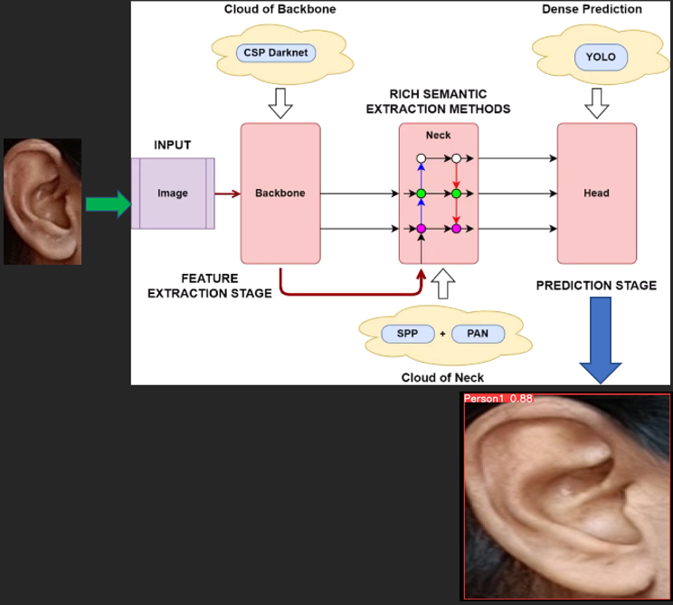
WORKING METHODOLOGY
A flow diagram for the whole algorithm:

Slide 16
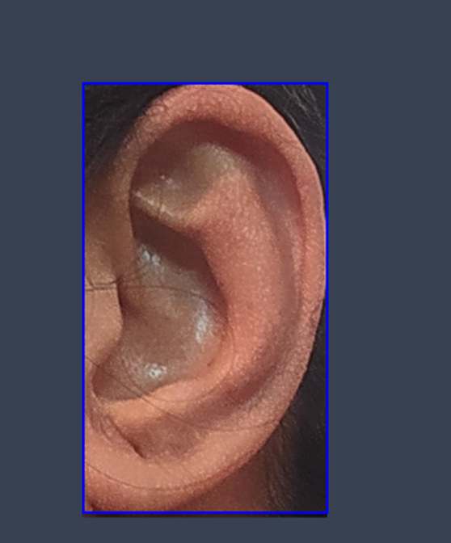
WORKING METHODOLOGY
In YOLOV5, images are needed to be annotated. For annotation , Roboflow online app was used. All the ear images were annotated and rescaled in 640X640. One of the annotated image is presented here:
Data processing before training:

Slide 17
WORKING METHODOLOGY
YOLO V5 is a single stage object detector.
YOLO V5 divides an image into 19X19 grids.

Slide 18
WORKING METHODOLOGY
Components of YOLOV5
Backbone
CSP Darknet 53
Neck
SPP block , PANet
Head
YOLO

Slide 19
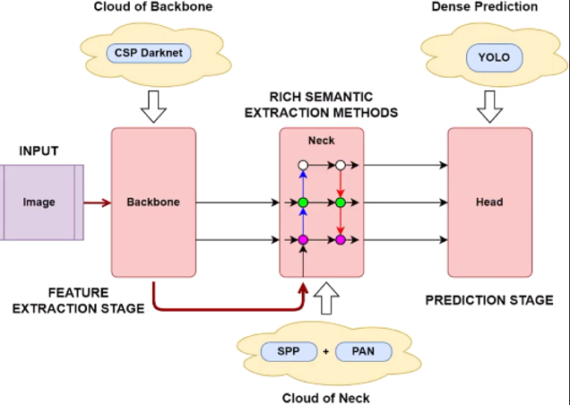
WORKING METHODOLOGY
Components of YOLOV5
Fig: Components of YOLO V5

Slide 20
WORKING METHODOLOGY
Feature extraction/output feature map:
DenseNet:
CSPDarknet53 uses Dense block and CSP block.
Every layer in DenseNet is connected to all the other layers.
DenseNet is the combination of all these Dense blocks.
Transition layer in between two dense block.
Transition layer is used for scaling down the spatial features.
Backbone

Slide 21
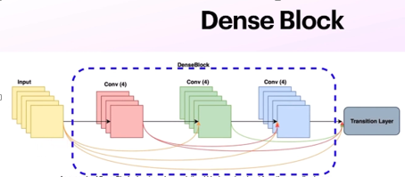
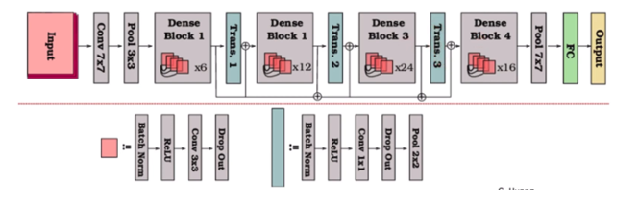
WORKING METHODOLOGY
Feature extraction/output feature map:
DenseNet:
Fig: Dense Block Fig: DenseNet

Slide 22
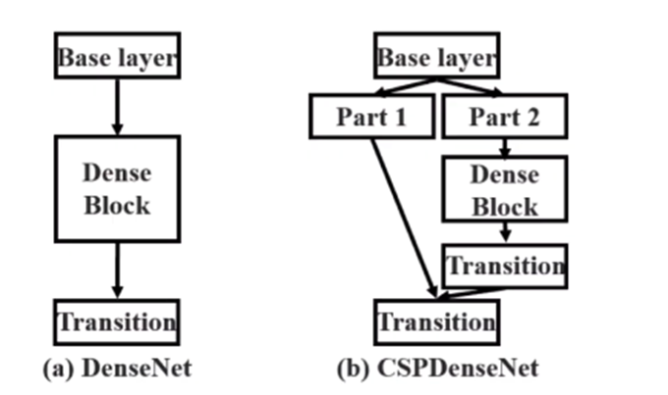
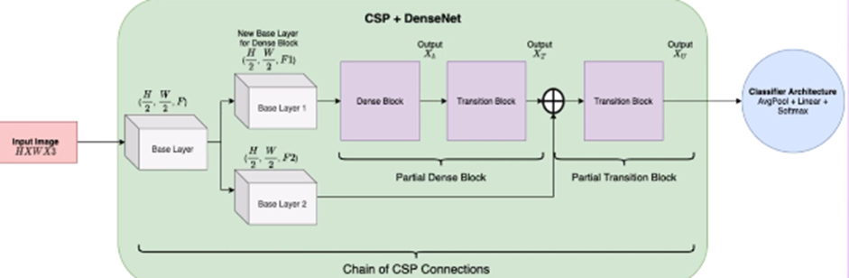
WORKING METHODOLOGY
Cross Stage Partial Network:
Half of the input is passed through the Dense Block and other half is directly passed to output for concatenation.
Extract rich feature from images.

Slide 23
WORKING METHODOLOGY
Feature Aggregation:
Neck is used to collect and aggregate information from different levels of feature maps.
It combines different set of features to provide better features for detection.
These new set of features are totally different from backbone’s feature output.
Feature Pyramid Network:
1.FPN is used to combine high and low level feature maps for preventing information loss.
2.It upscales next level feature maps and connects them through lateral connection.
Neck

Slide 24
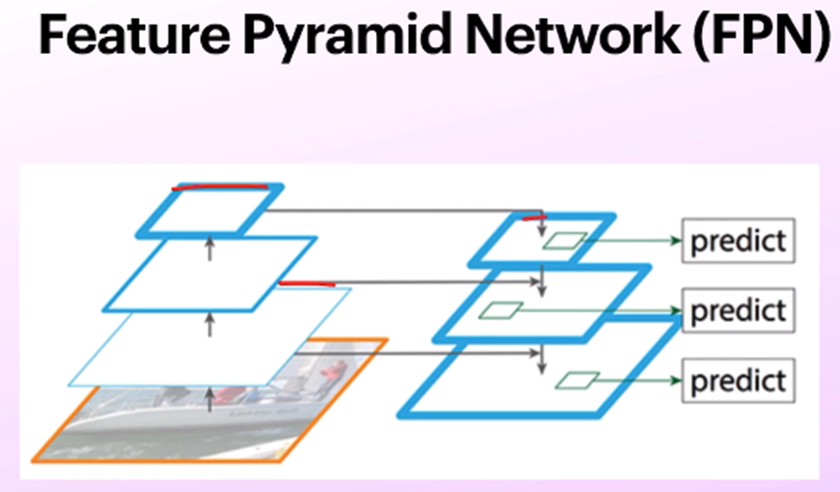
WORKING METHODOLOGY
Fig: Diagram of FPN

Slide 25
WORKING METHODOLOGY
Path Aggregation Network(PANet):
PANet is an extension of FPN.
It creates a bottom up approach for feature mapping from different levels
It adds an extra branch.
The information path is shortened.
PANet consists of FPN, Adaptive feature pooling and flattening layers.

Slide 26
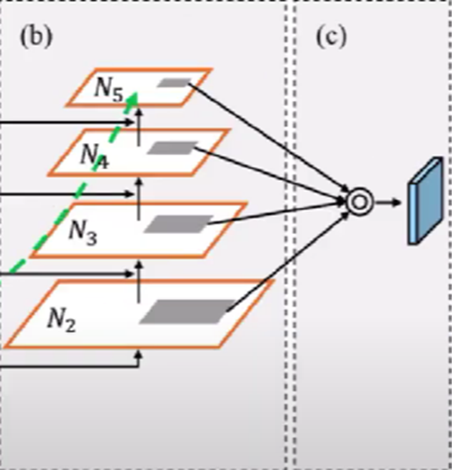
WORKING METHODOLOGY
4. All the layer’s features are combined using adaptive feature pooling. So without doing prediction in all the levels independently, all the features are combined. So after pooling the best feature map is found.
Path Aggregation Network(PANet):

Slide 27
WORKING METHODOLOGY
5. ROIAlign extracts features from different levels. and
6. It creates features maps of same size blocks.
6. Same size feature maps are flattened into 1D feature vectors.
7. Element wise sum or maximum is taken to create a new feature vector.
Path Aggregation Network(PANet):

Slide 28
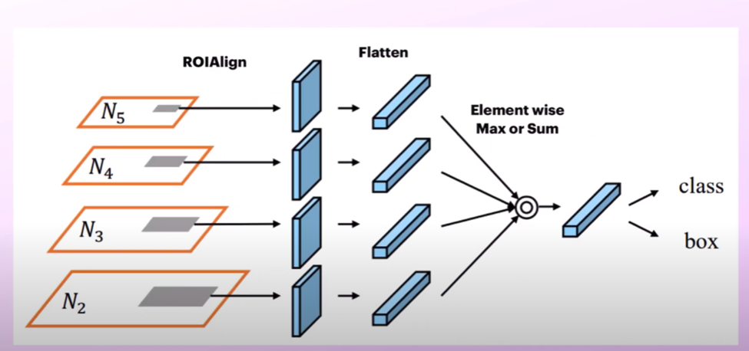
WORKING METHODOLOGY
Path Aggregation Network(PANet):

Slide 29
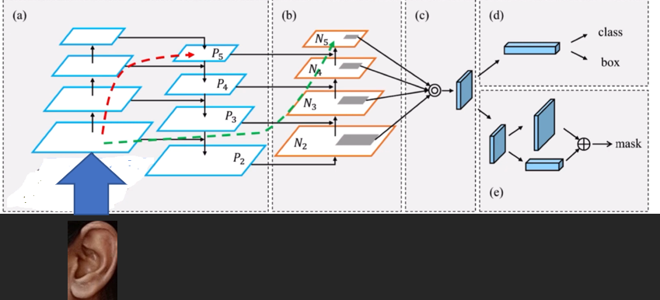
WORKING METHODOLOGY
Path Aggregation Network(PANet):

Slide 30
WORKING METHODOLOGY
Spatial Pyramid pooling(SPP):
It is used to get more significant convolutional layer of CSPDarkNet53 as a pooling layer is removed and that particular layer is replaced by SPP layer.
This layer takes a particular feature and takes different levels of features from the pooling. This gives fixed length representation to fully connected layer.
It applies grid on a particular image and takes the highest pixel value to get the most significant feature.
A fixed size feature map will be found through SPP which will finally be concatenated before passing to the next layers.

Slide 31
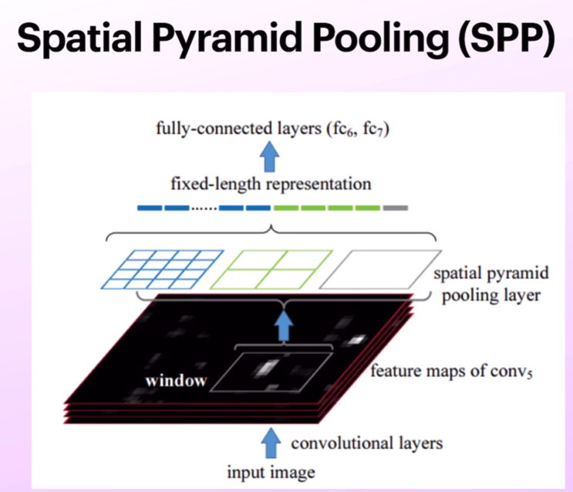
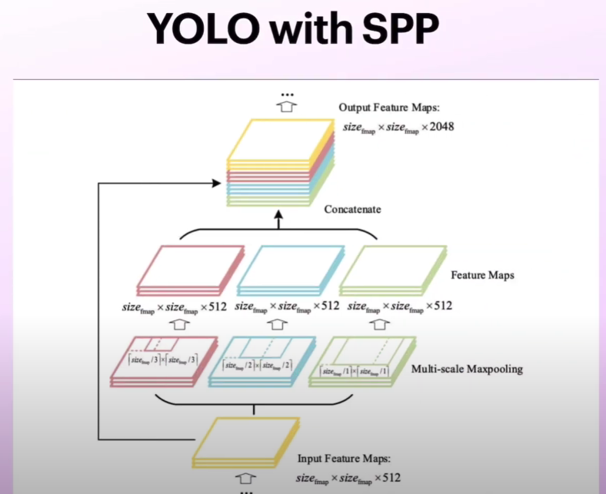
WORKING METHODOLOGY

Slide 32
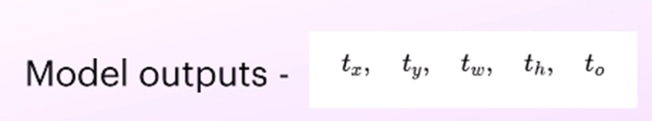
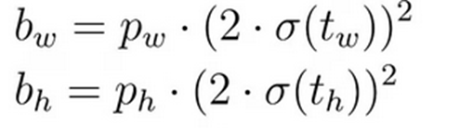
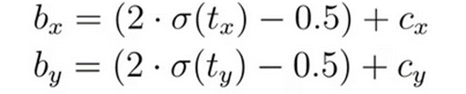
WORKING METHODOLOGY
Head:
Head is used for -
Boundary box prediction.
Class prediction.
Objectness score.
Bounding Box Prediction:
For bounding box the network will output four offset values.
The 4 values are- tx, ty, tw and th. Here tx and ty are co-ordinates and tw and th are width and height respectively.

Slide 33
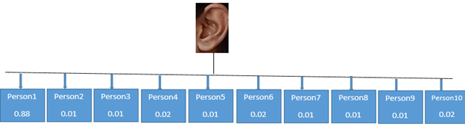
WORKING METHODOLOGY
Head:
Class Prediction:
In our purpose, the classification problem is multiclass classification.
Softmax activation function is used for class probabilities.
Every class will given a probability score and the total of all the probability score will be 1.
The class with the highest probability score will be the predicted class.
Fig. Multiclass Classification of YOLO V5.

Slide 34
WORKING METHODOLOGY
HAAR Cascade Classifier

Slide 35
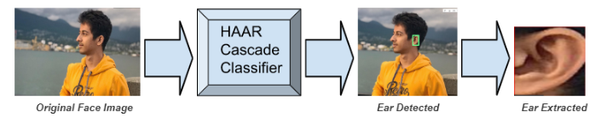
WORKING METHODOLOGY~HAAR CASCADE CLASSIFIER

Slide 36
WORKING METHODOLOGY~HAAR CASCADE CLASSIFIER
Vertical HAAR features
Types of HAAR features for human ear
Centre-Surround HAAR features
Horizontal HAAR features
Four-rectangle HAAR features

Slide 37
WORKING METHODOLOGY~HAAR CASCADE CLASSIFIER
Calculating HAAR features of human ear
Creating integral images from the original image of the human ear
Adaboost training
Implementing cascading classifier

Slide 38
WORKING METHODOLOGY~HAAR CASCADE CLASSIFIER
Calculation of HAAR features:
Calculation of HAAR features of human ear
Avg. of pixel values of the darker region of human ear e.g., canal, concha
Avg. of pixel values of the lighter region of human ear e.g., helix, antihelix
**If the difference is close to 1, then a feature is selected**

Slide 39
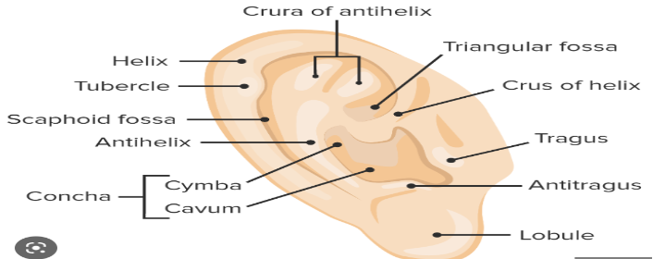
WORKING METHODOLOGY~HAAR CASCADE CLASSIFIER
Fig. Darker and lighter regions of human ear

Slide 40
WORKING METHODOLOGY~HAAR CASCADE CLASSIFIER
Creating integral images of human ear:
Each pixel of integral image
The SUM of all pixels lying to its left and above in the original ear image
Integral images are needed to speed up the calculation of HAAR features.

Slide 41
WORKING METHODOLOGY~HAAR CASCADE CLASSIFIER
Adaboost training and implementing cascade classifier:
Choosing the best features of ear
Training the classifier to use those features
Detecting human ear using the weak classifiers and strong classifiers

Slide 42
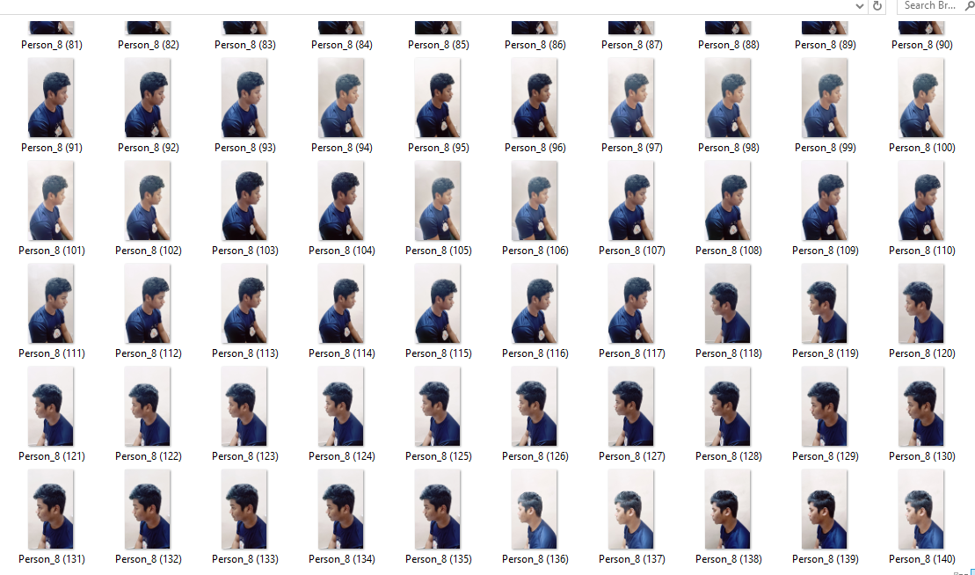
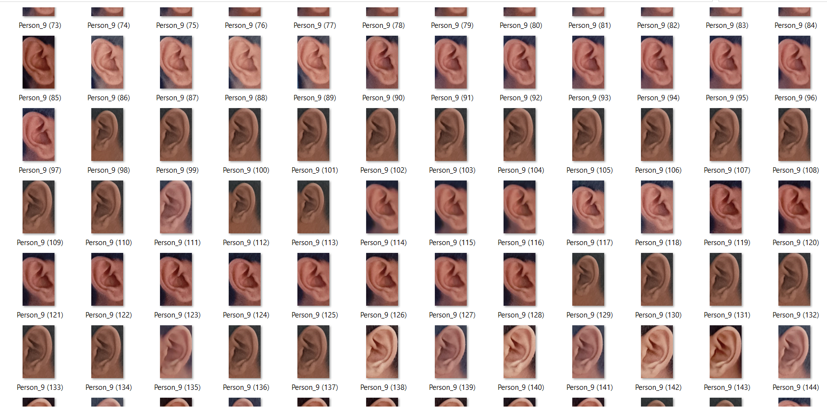
WORKING METHODOLOGY~HAAR CASCADE CLASSIFIER
HAAR Cascade Classifier to create AUSTEARID205X10 dataset:
HAAR Cascade Classifier

Slide 43
WORKING METHODOLOGY
MobileNet-SSD

Slide 44
WORKING METHODOLOGY
MobileNet-SSD
In MobileNet architecture, employs depthwise separable convolution(depthwise convolution+pointwise convolution)
SSD(Single Shot Detector) which is known as feed forward that generates multiple bounding boxes and scores them based on the existence of objects.
SSD typically added framework as base network such as MobileNet to extract features and build an ensembled form for significantly more faster and accurate detection.
SSD can detect object in a single pass which can saves a lot of time and reduce the computational cost.

Slide 45
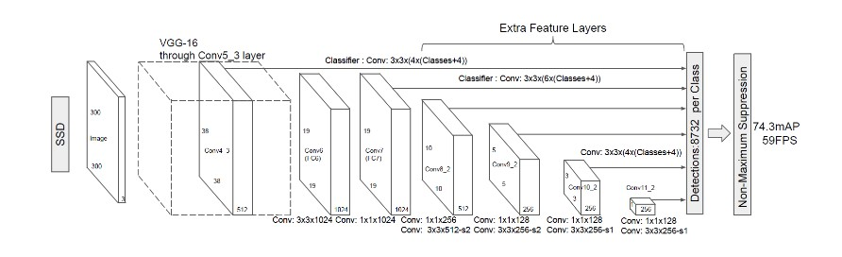
WORKING METHODOLOGY
SSD-MobileNet Architecture.

Slide 46
WORKING METHODOLOGY
Architecture of SSD Model:
The SSD Model has two parts:
The Backbone Model
The SSD Head
The Backbone Model:
It is typical pre-trained image classification network that works as a feature map extractor.
In this step final image classification layers of the model are removed to give us only the extracted feature map.
The SSD Head:
SSD Head is made up of a couple of convolutional layers stacked together and it added to the top of the backbone model
This gives us output as bounding boxes over the objects

Slide 47
WORKING METHODOLOGY
How SSD Work:
SSD based on the CNN that produce multiple bounding boxes of various fixed sizes and scores the presence of the object class instance in those boxes by a non- maximum suppression step to produce the final detections
In this model VGG-16 is the backbone model
Pascal voc is our ear image Dataset for every image we need to create xml file for this dataset
In SSD each input image is divided into grids of various sizes
In each grid ,the detection is performed for different classes and different aspect ratios.
The grid helps to detect how well an object matches in that particular grid.

Slide 48
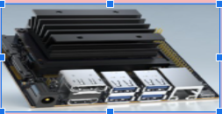
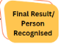

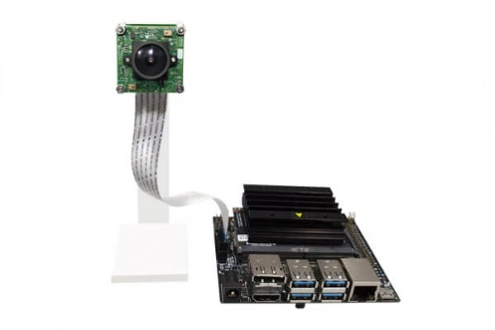
Working Methodology for present work
Deploy on jetson-nano
processing
Yolo V5+Haarcascade

Slide 49
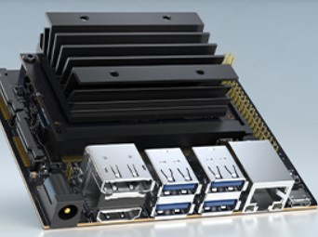
What is jetson-nano
Jetson-nano is a small, powerful computer designed to power entry-level edge AI applications and devices.
It uses a version of Linux (Ubuntu 18.04 LTS) as its operating system.
It is based on ARM architecture.
Fig: Jetson Nano Developer Kit

Slide 50
Jetson-nano Configuration
Before deployment on jetson nano,first of all, we have to install all dependencies before deployment.
1) Board Setup: In this step, here we installed all dependencies such as SDK manager and also check Jetson os.
2) Jetson Nano sub startup: Check power supply, Move the root file system EMMC flash to SD card storage directly.
3) Installing Anaconda: Install anaconda for linux system AArch64 architecture because regular Anaconda does not work.
Thus,Jetson nano ready for deployment.

Slide 51
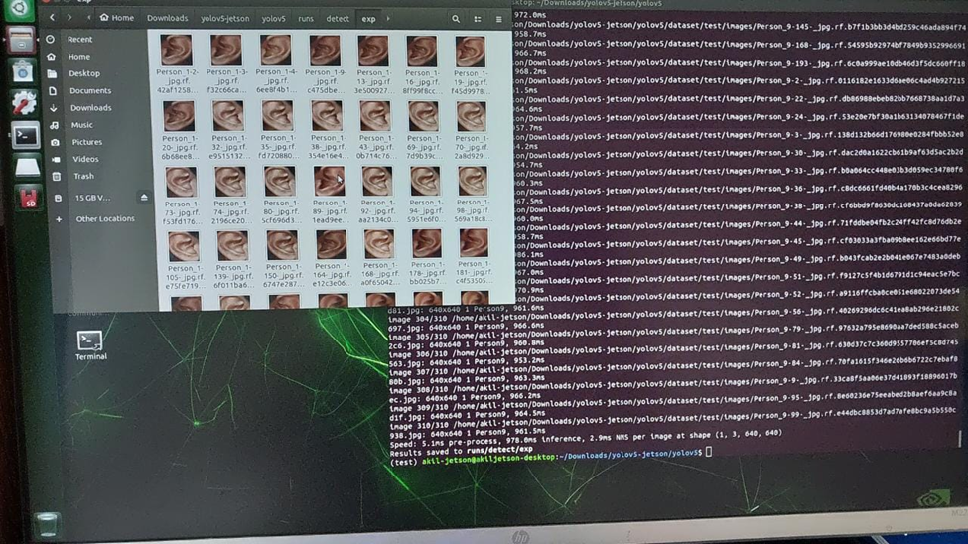
Real time testing and Implementation on Jetson Nano
1)Testing the pretrained model on jetson nano:
Testing on jetson Nano

Slide 52
Real Time Person Identification on Jetson Nano
For real time person identification we have to capture the image using camera than it stored in a folder.
Than cropped the image of ear through haar cascade classifier.
After than YOLO V5 train the images and finally person are identified in real time.
Capture Real time image using Camera
Extracted ear using Haar cascade
Person identification using YOLO V5
From these image
Using these image
Fig: Working flow on real time person identification

Slide 53
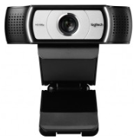
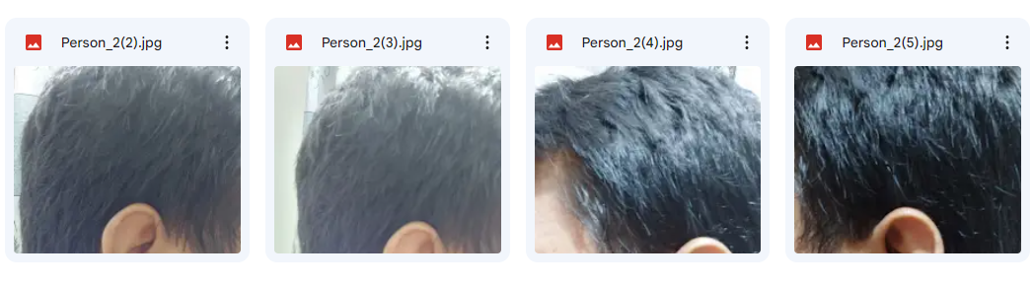

Real time Implementation on Jetson Nano
Step:1 Capture the real time image using camera : After capturing all the image and store it in a folder.
’
Camera
Taking picture on real time
Store it in a Imagefolder
Real time image capturing.

Slide 54
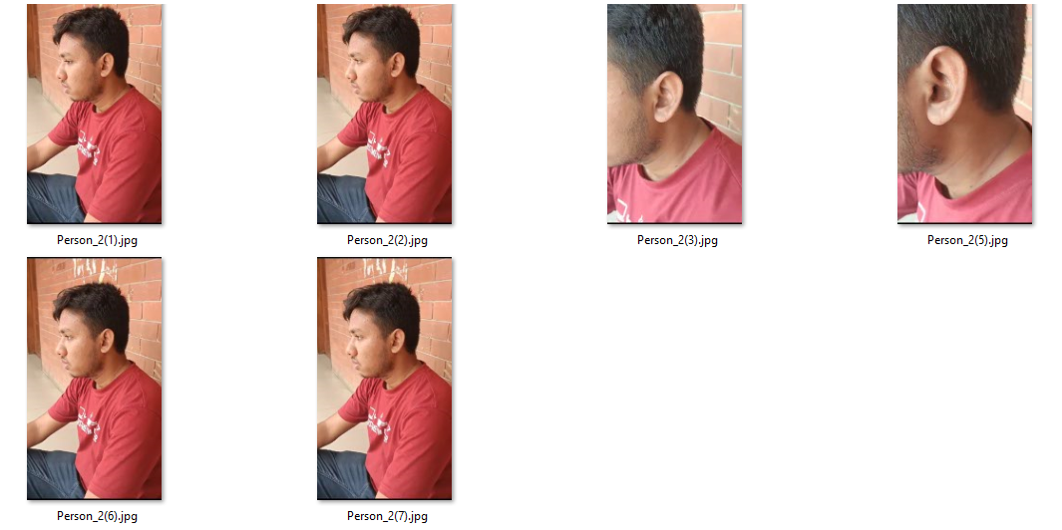

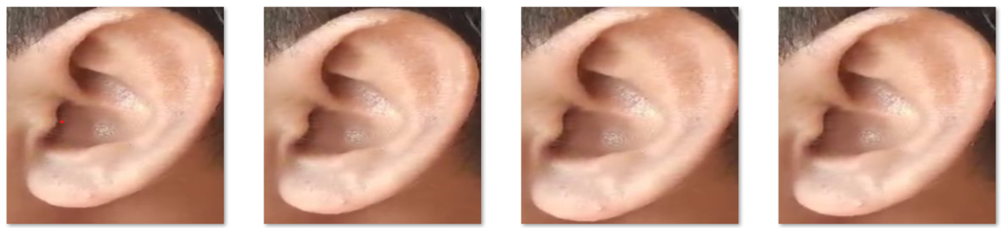
Real time Implementation on Jetson Nano
Step:2 Extracted Ear from Image: Using Haar Cascade both left and right ear.
.
Extracted ear images from real time capturing image.

Slide 55
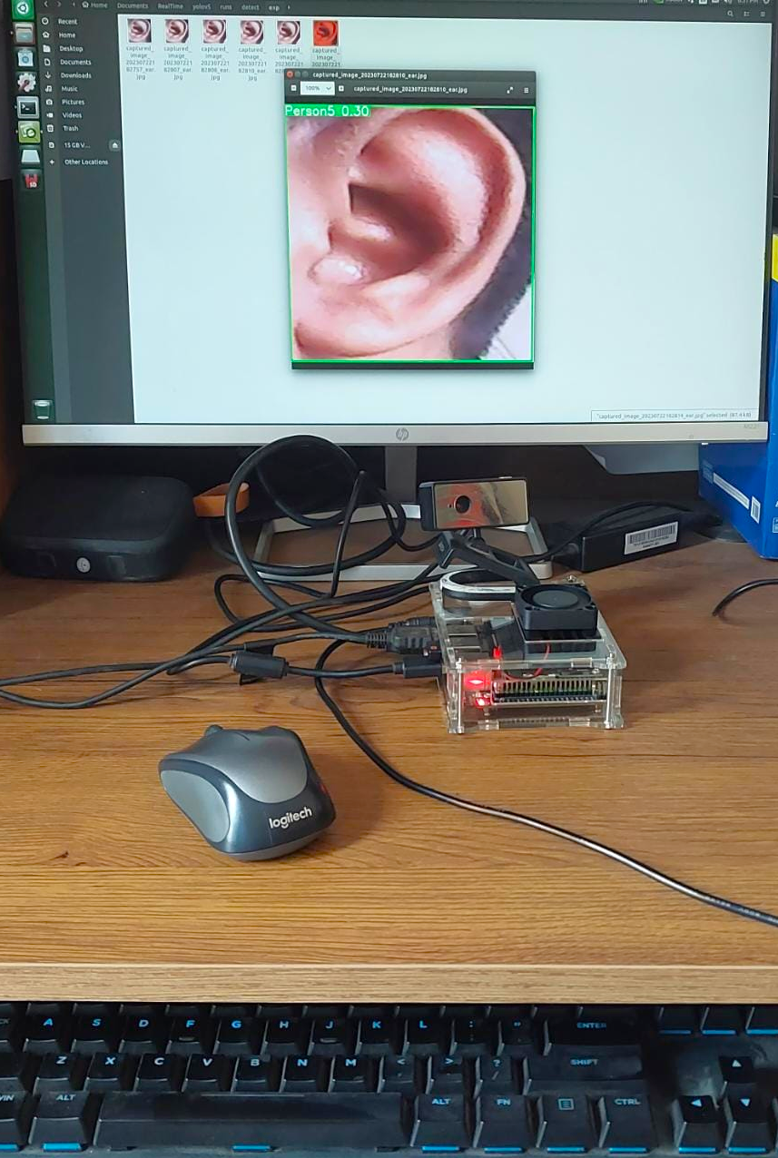
Real time Implementation on Jetson Nano
Step:3 Person identification using jetson nano: After extracted ear images,than it trained the images and identifies the person in real time using YOLO V5 which is deployed on jetson Nano.
.
Person identification using jetson Nano

Slide 56
REQUIREMENT ANALYSIS~SOFTWARE REQUIREMENT SPECIFICATION
1.Purpose:
Identify a person correctly in real-time
2.Intended Audience:
Members of the organization
System developers
3.Scope:
Distributed DB system by ensuring interconnectivity between databases
Automatic attendance system
4.Software & Hardware Requirements:
Programming Language: Python
Software requirements: HAAR Cascade, YOLOv5, MobileNetSSDv1,v2
Hardware requirements: Camera, Keyboard, Monitor, Jetson-Nano, SD Card (32 GB), Power supply, etc.
5.Constraints:
Identified Person will be authenticated
Unidentified Person will not be authenticated
6.User Characteristics:
Showing users ear while passing in front of the camera is compulsory
7.Functional Requirements:
Ear Segmentation: HAAR Cascade
Pre-trained YOLOv5 generated from dataset
Generating Hardware System: Embedded version of HAAR Cascade & pre-trained YOLOv5 into Jetson-Nano along with camera.
8.Dataset Requirements:
Ear images of the members of the organization
9. Non-Functional Requirements:
Cost of running system
Camera quality
Accuracy of system

Slide 57
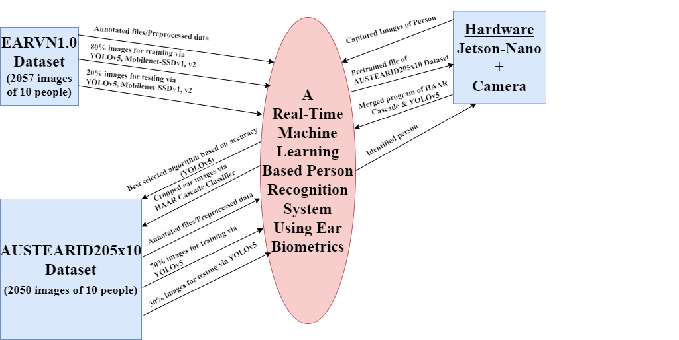
CONTEXT DIAGRAM~ DFD (DATA FLOW DIAGRAM)
Context Level DFD

Slide 58
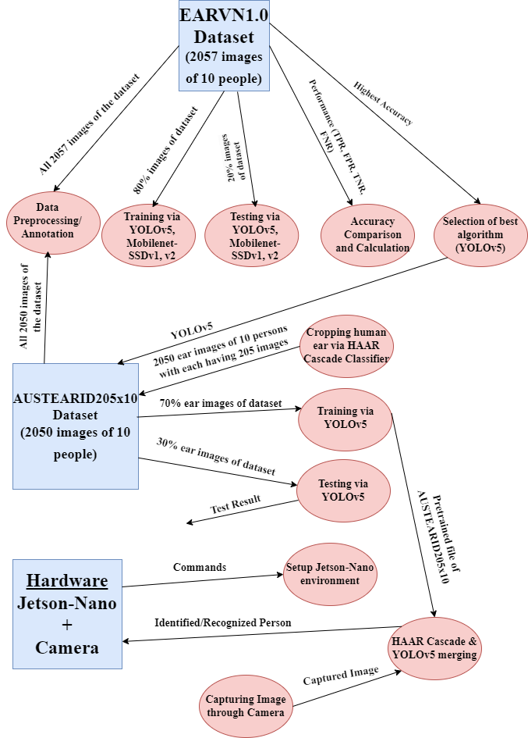
CONTEXT DIAGRAM~ DFD (DATA FLOW DIAGRAM)
Level 0 DFD

Slide 59
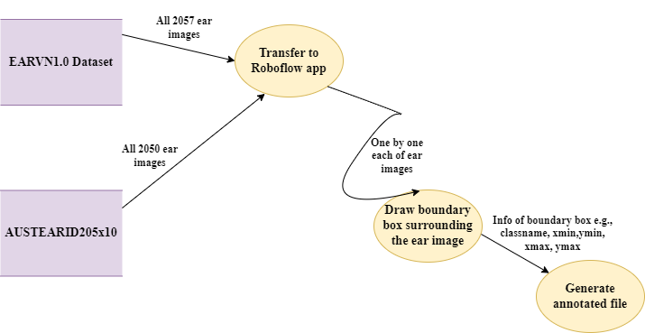
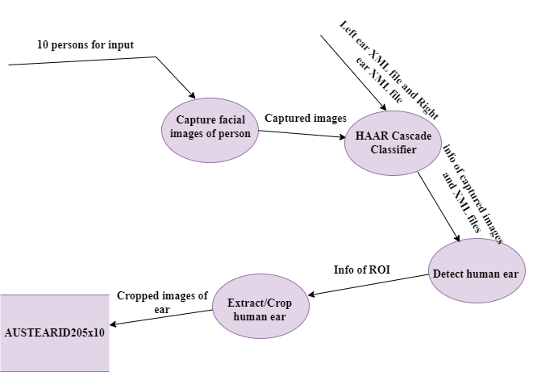
CONTEXT DIAGRAM~ DFD (DATA FLOW DIAGRAM)
Level 1 DFD for Data Preprocessing:
Level 1 DFD for Cropping Human Ear via HAAR Cascade:

Slide 60
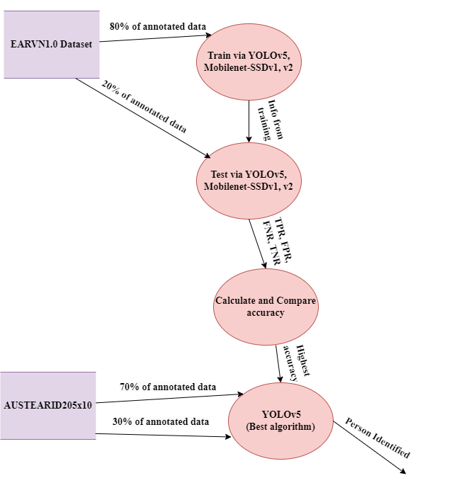
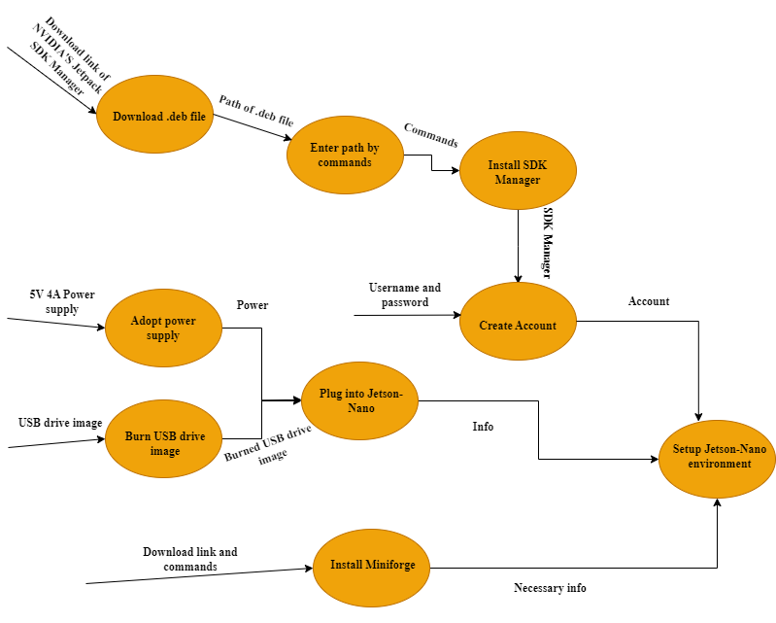
CONTEXT DIAGRAM~ DFD (DATA FLOW DIAGRAM)
Level 1 DFD for Training & Testing Data:
Level 1 DFD for Jetson-Nano Setup:

Slide 61
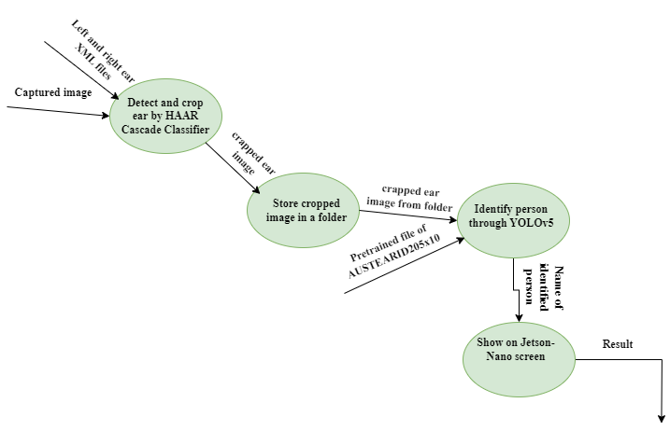
CONTEXT DIAGRAM~ DFD (DATA FLOW DIAGRAM)
Level 1 DFD for Merging HAAR Cascade & Pre-trained YOLOv5 Model

Slide 62
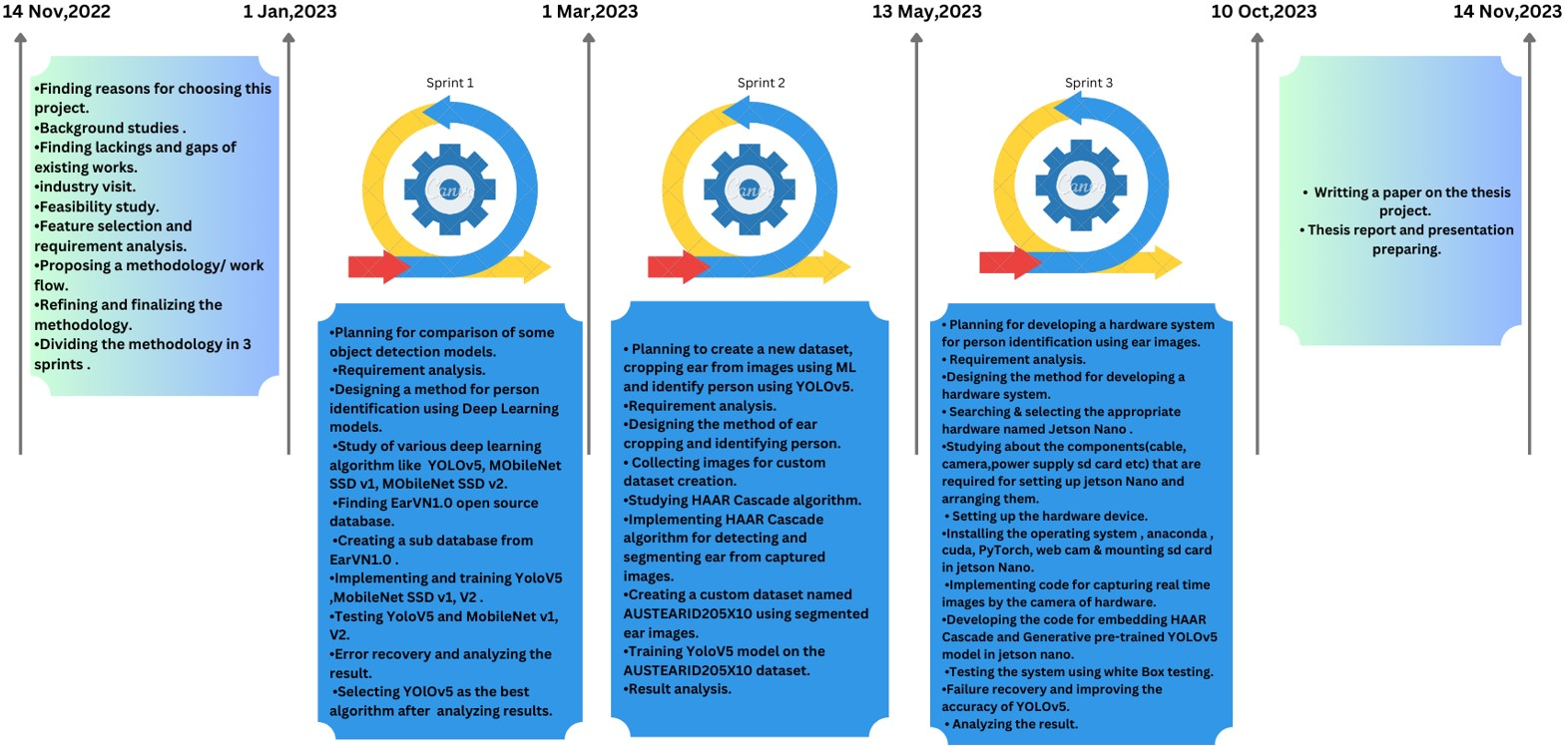
Gantt Chart

Slide 63
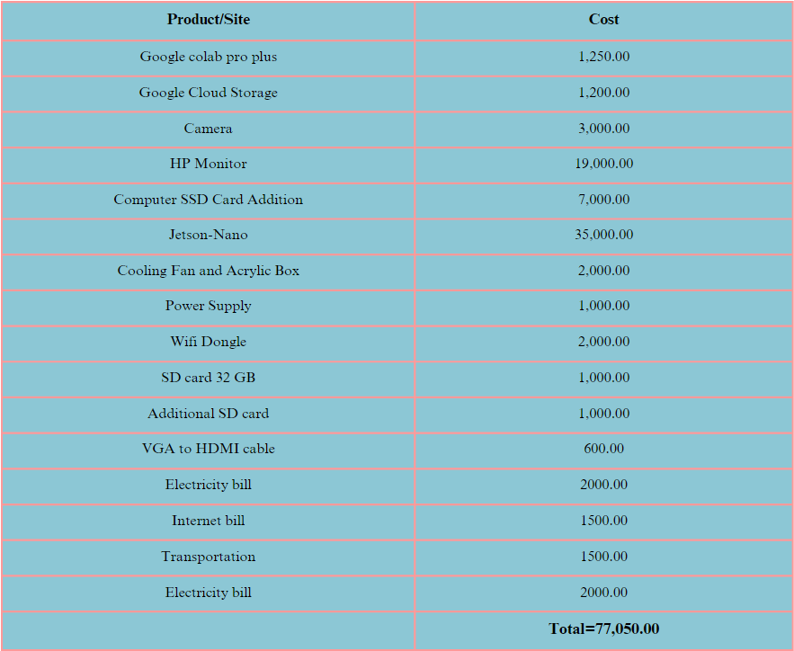
COST ANALYSIS

Slide 64
RESULT ANALYSIS~Training Status of Models on EARVN1.0 Dataset
Model | Epochs | Time | Retrained Model size
MobileNet-SSDv1 | 200 | 4.19 hrs | 32 MB
MobileNet-SSDv2 | 200 | 3.40 hrs | 16 MB
YOLOv5 | 260 | 4.50 hrs | 16 MB

Slide 65
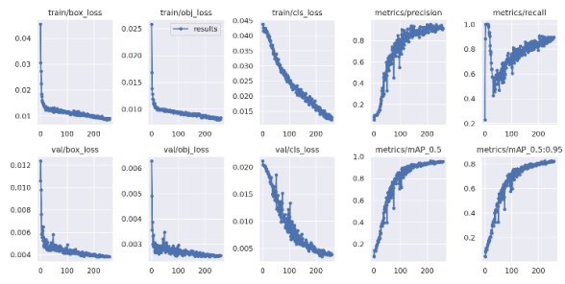
RESULT ANALYSIS-Training Result of YOLOv5 on EARVN1.0 Dataset
Fig. Training result of Yolo V5

Slide 66
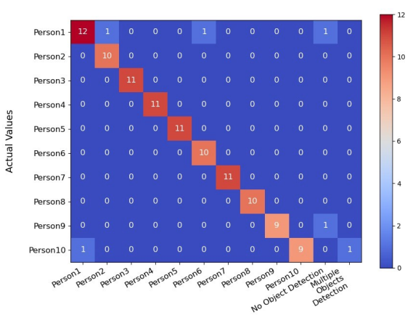
RESULT ANALYSIS~EARVN1.0 Dataset
Matrix of YOLO V5 Test Result

Slide 67
RESULT ANALYSIS~Test result analysis of YOLOv5 on EARVN1.0
Class | Precision | Recall | F1-score
Person1 | 0.92 | 0.80 | 0.86
Person2 | 0.91 | 1.00 | 0.95
Person3 | 1.00 | 1.00 | 1.00
Person4 | 1.00 | 1.00 | 1.00
Person5 | 1.00 | 1.00 | 1.00
Person6 | 0.91 | 1.00 | 0.95
Person7 | 1.00 | 1.00 | 1.00
Person8 | 1.00 | 1.00 | 1.00
Person9 | 1.00 | 0.90 | 0.95
Person10 | 1.00 | 0.82 | 0.90

Slide 68
RESULT ANALYSIS~Test result analysis of YOLOv5 on EARVN1.0
Precision
96.1%
YOLOv5
Recall
96.1%
Micro-F1
96%
Weighted-F1
96%

Slide 69
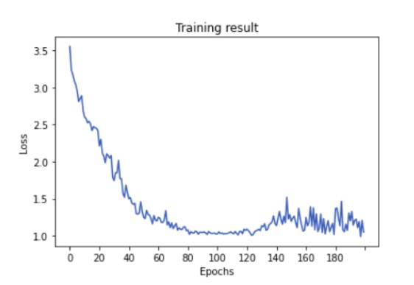
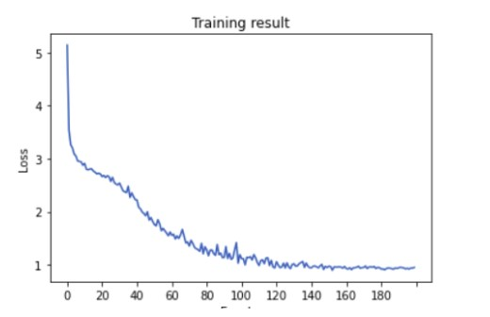
RESULT ANALYSIS
MobileNet-SSD: After training MobileNet-SSD(V1,V2) calculate confusion matrix show the performance of result using test datasets and then calculate the precision,recall,F1 score for both algorithms.
Loss value of MobileNetV1
Loss value of MobileNetV2

Slide 70


RESULT ANALYSIS
Matrix of MobileNetV1 Test Result
Matrix of MobileNetV2 Test Result

Slide 71
RESULT ANALYSIS~Test result analysis of MOBILENET-SSDv1 on EARVN1.0
Class | Precision | Recall | F1-score
Person1 | 0.93 | 0.87 | 0.90
Person2 | 0.80 | 0.80 | 0.80
Person3 | 0.82 | 0.82 | 0.82
Person4 | 1.00 | 1.00 | 1.00
Person5 | 1.00 | 1.00 | 1.00
Person6 | 0.90 | 0.90 | 0.90
Person7 | 1.00 | 0.91 | 0.95
Person8 | 0.69 | 0.90 | 0.78
Person9 | 1.00 | 0.80 | 0.89
Person10 | 0.88 | 0.64 | 0.74

Slide 72
RESULT ANALYSIS~Test result analysis of MOBILENET-SSDv2 on EARVN1.0
Class | Precision | Recall | F1-score
Person1 | 1.00 | 0.87 | 0.93
Person2 | 0.91 | 1.00 | 0.95
Person3 | 0.90 | 0.82 | 0.86
Person4 | 1.00 | 0.82 | 0.90
Person5 | 0.83 | 0.91 | 0.87
Person6 | 0.83 | 1.00 | 0.91
Person7 | 0.90 | 0.82 | 0.86
Person8 | 1.00 | 1.00 | 1.00
Person9 | 0.89 | 0.80 | 0.84
Person10 | 1.00 | 0.91 | 0.95

Slide 73
RESULT ANALYSIS~Comparison of MobileNet-SSD(v1,v2) & YOLOv5
Model | Micro-F1 | Macro-F1 | Weighted-F1
MobileNet-SSDv1 | 0.88 | 0.88 | 0.88
MobileNet-SSDv2 | 0.91 | 0.91 | 0.91
YOLOv5 | 0.96 | 0.96 | 0.96

Slide 74
RESULT ANALYSIS~Test result analysis of MobileNet-SSDv1 on EARVN1.0
Precision
90.2%
MobileNet-SSDv1
Recall
86.4%
Micro-F1
88%
Weighted-F1
88%

Slide 75
RESULT ANALYSIS~Test result analysis of MobileNet-SSDv2 on EARVN1.0
Precision
90.6%
MobileNet-SSDv2
Recall
89.4%
Micro-F1
91%
Weighted-F1
91%

Slide 76
RESULT ANALYSIS~Comparison of MobileNet-SSD(v1,v2) & YOLOv5
Model | Precision | Recall | Micro-F1 | Weighted-F1
MobileNet-SSDv1 | 90.2% | 86.4% | 88% | 88%
MobileNet-SSDv2 | 92.6% | 89.4% | 91% | 91%
YOLOv5 | 96.1% | 96.1% | 96% | 96%

Slide 77
RESULT ANALYSIS~Comparison of MobileNet-SSD(v1,v2) & YOLOv5
Model | Epochs | Time | Retrained Model size
MobileNet-SSDv1 | 200 | 4.19 hrs | 32 MB
MobileNet-SSDv2 | 200 | 3.40 hrs | 16 MB
YOLOv5 | 260 | 4.50 hrs | 16 MB

Slide 78

RESULT ANALYSIS-Training Result of YOLOv5 on AUSTEARID205X10 Dataset
Fig. Training result of YOLOv5 on AUSTEARID205X10 Dataset

Slide 79

RESULT ANALYSIS~AUSTEARID205X10 Dataset
Fig. Matrix of YOLOV5 Test Result on AUSTEARID205X10

Slide 80
RESULT ANALYSIS~Test result analysis of YOLOv5 on AUSTEARID205x10
Class | Precision | Recall | F1-score
Person1 | 1.00 | 0.94 | 0.969
Person2 | 1.00 | 1.00 | 1.00
Person3 | 0.97 | 1.00 | 0.98
Person4 | 0.94 | 1.00 | 0.97
Person5 | 0.97 | 1.00 | 0.98
Person6 | 0.97 | 0.91 | 0.95
Person7 | 0.97 | 1.00 | 0.98
Person8 | 1.00 | 0.97 | 0.98
Person9 | 0.97 | 0.97 | 0.97
Person10 | 1.00 | 0.97 | 0.98

Slide 81
RESULT ANALYSIS~Test result analysis of YOLOv5 on AUSTEARID205x10
YOLOv5
Precision
98%
Recall
97.9%
Micro-F1
97.7%

Slide 82
RESULT ANALYSIS~PERFORMANCE ANALYSIS OF YOLOv5 IN JETSON-NANO
PREDICTED PERSON
 | p1 | p2 | p3 | p4 | p5 | p6 | p7 | p8 | p9 | p10
p1 | 25 | 2 | 0 | 0 | 1 | 1 | 0 | 0 | 1 | 0
p2 | 1 | 23 | 1 | 3 | 0 | 0 | 1 | 0 | 1 | 0
p3 | 1 | 0 | 24 | 1 | 0 | 0 | 1 | 1 | 1 | 1
p4 | 0 | 2 | 0 | 24 | 0 | 2 | 0 | 1 | 1 | 0
p5 | 0 | 0 | 1 | 0 | 25 | 0 | 2 | 0 | 2 | 0
p6 | 1 | 2 | 0 | 0 | 2 | 22 | 0 | 3 | 0 | 0
p7 | 0 | 1 | 1 | 0 | 1 | 0 | 25 | 2 | 0 | 0
p8 | 0 | 0 | 2 | 1 | 1 | 0 | 0 | 24 | 1 | 1
p9 | 3 | 0 | 3 | 0 | 1 | 0 | 0 | 0 | 23 | 0
p10 | 1 | 1 | 2 | 0 | 1 | 0 | 0 | 0 | 2 | 23
A\P
ACTUAL
PERSON
’
.

Slide 83
RESULT ANALYSIS~TEST RESULT ANALYSIS OF YOLOv5 IN JETSON-NANO
Class | Precision | Recall | F1-score
Person1 | 0.78 | 0.83 | 0.80
Person2 | 0.74 | 0.77 | 0.75
Person3 | 0.71 | 0.80 | 0.75
Person4 | 0.83 | 0.80 | 0.81
Person5 | 0.78 | 0.83 | 0.80
Person6 | 0.88 | 0.73 | 0.79
Person7 | 0.86 | 0.83 | 0.84
Person8 | 0.77 | 0.80 | 0.78
Person9 | 0.72 | 0.77 | 0.74
Person10 | 0.92 | 0.77 | 0.83

Slide 84
RESULT ANALYSIS
Algorithm | FPS
HAAR Cascade | 15
YOLOv5 | 1.4

Slide 85
FUTURE PLAN
Authentication of appropriate persons in different organizations
Interconnectivity between devices
Use of fabricated device to minimize the cost of whole system
System Oriented Platform or API development
Creating open data system
.

Slide 86
REFERENCES
1)HEARD: An Automatic Human EAR Detection Technique.
2)Automatic Ear Detection and Feature Extraction using Geometric Morphometrics and Convolutional Neural Networks
3)Real-Time Human Ear Detection Based on the Joint of Yolo and Retina Face.
4)Real time Ear Recognition using Deep Learning.
5)A Deep Learning Approach for Person Identification using Ear Biometrics.
6)A Real-time Machine Learning-Based Person Recognition System with Ear Biometrics.
7)https://developer.nvidia.com/embedded/jetpack
8) https://www.forecr.io/blogs/bsp-development/change-root-file-system-to-sd-card-directly
9) http://www.yahboom.net/study/jetson-nano
10) https://github.com/conda-forge/miniforge
11) https://sahilchachra.medium.com/setting-up-nvidias-jetson-nano-from-jetpack-to-yolov5-60a004bf48bc
12) https://app.diagrams.net/

Slide 87

THANK YOU

